Slide 1
Emission Spectrum Animation
Physics TEKS 8(B)

Slide 2
Objective: 8(A) compare and explain the emission spectra produced by various atoms
Activity: Students will be able to drag different elements to the light source of the spectrometer to compare their emission spectra. There is already an animation that does this, but it would be useful to have more elements.
The elements in the tubes can be hydrogen, helium, mercury, sodium, and neon. (There is already a neon tube). They have their own tube, light rays that project onto the screen, a spectrum on the screen that is connected to a machine, and spectrum on an interactive display screen for the students.

Slide 3

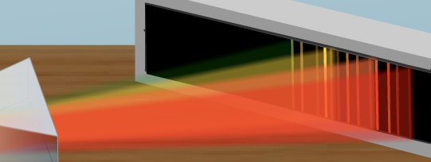
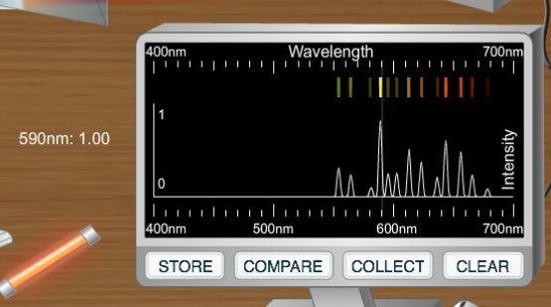
For example: Neon
tube
When you drag the cursor over the graph, the intensity shows up to the left of the machine. I will supply a table of wavelengths and intensities for each element.
light rays
spectrum on screen
These two should be the same.
This is a graph of the spectrum. The higher the lines are on this graph, the more intense the colors right above them (and the light rays and spectrum on the screen in the other picture) should be.

Slide 4
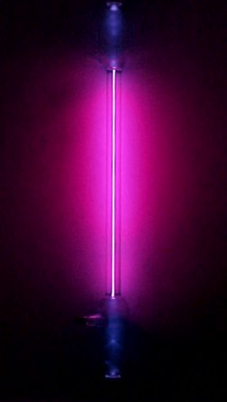

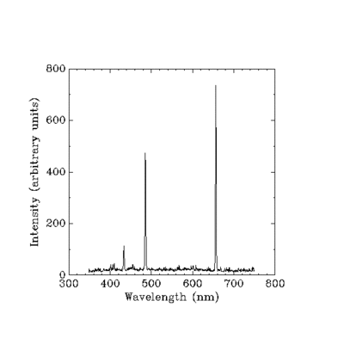
Hydrogen
The tube should be close to this color.
The spectrum on each screen should look like this. The numbers below show exactly where the lines go.
410
434
486
656
Table showing what value of intensity should show up when the student scrolls over different wavelengths
Wavelength | Intensity
410 | 0.02
434 | 0.11
486 | 0.50
656 | 0.75
The graph of the spectrum should be a simplified version of this.

Slide 5
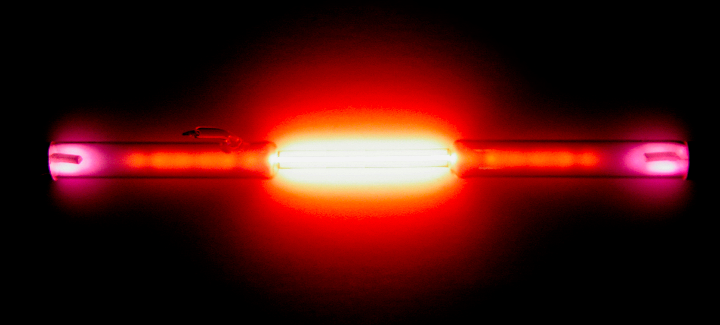

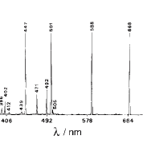
Helium
The tube should be close to this color.
The spectrum on each screen should look like this. The numbers below show exactly where the lines should go. Ignore any lines that don’t have a number below them.
402
447
471
492
587
667
501
Wavelength | Intensity
402 | 0.03
447 | 0.26
471 | 0.06
492 | 0.07
501 | 0.35
587 | 1.00
667 | 0.32
The graph of the spectrum should be a simplified version of this.

Slide 6
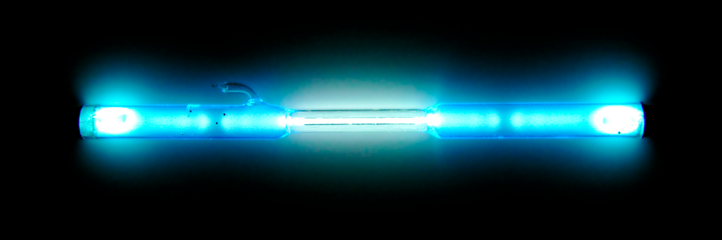

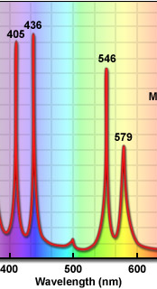
Mercury
The tube should be close to this color.
The spectrum on each screen should look like this. The numbers below show exactly where the lines should go. Ignore any lines that don’t have a number below them.
404
435
502
546
577
579
Wavelength | Intensity
404 | 0.92
435 | 0.97
502 | 0.08
546 | 0.82
577 | 0.50
579 | 0.50
The graph of the spectrum should be a simplified version of this.

Slide 7
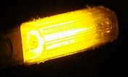

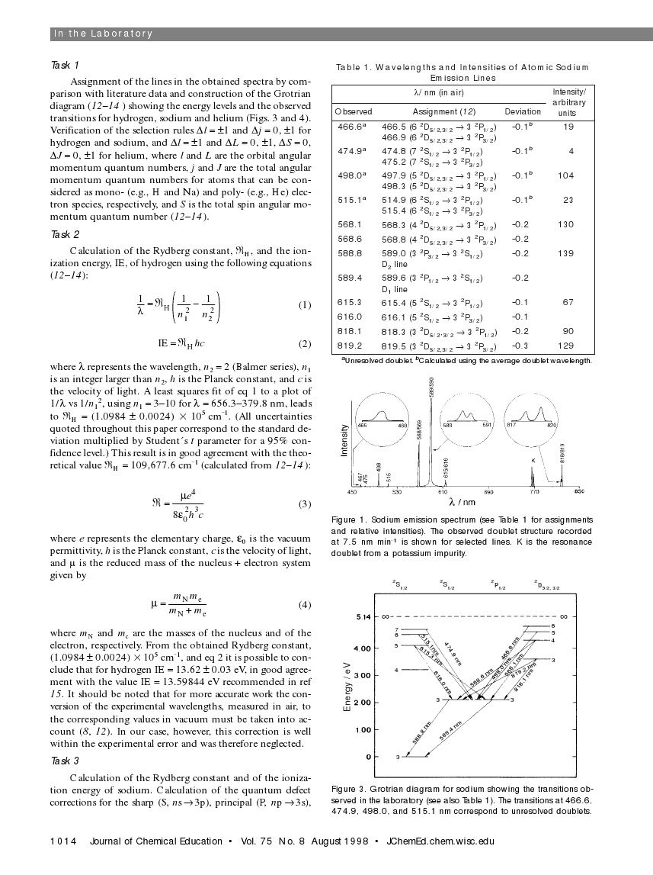
Sodium
The tube should be close to this color.
The spectrum on each screen should look like this. The numbers below show exactly where the lines should go. Ignore any lines that don’t have a number below them.
568
588
466
498
Wavelength | Intensity
466 | 0.14
498 | 0.75
568 | 0.94
588 | 1.00
The graph of the spectrum should be a simplified version of this. Ignore the circles.

