Slide 2
Student Learning Outcomes/Objectives

Slide 3



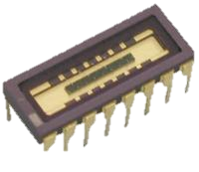

How an Emission Spectrum is Collected (Figure presented is a general idea of the layout)
This is an introduction as well as the gateway to the entire spectroscopy module.
From this interface I envision the students being able to study different samples and access the subsequent simulations.
The main goal is to get students to understand how a spectrum is collected.
The principle components here are
the visualization of light generated by a sample
Light passing through a prism and being separated in space by wavelength
Recording the light intensity and wavelength in the form of a spectrum
These elements can be described in call-out panels as the student clicks on a particular component or some information icon near each component.
Information Icon
Ideally the intensity of the different visible bands would qualitatively change based on the sample analyzed.
The students will operate within this interface throughout the entire module.
It may be best for the computer terminal to be a bit larger and the prism and detector to be smaller.
In subsequent modules there will be control buttons on the computer and they will have to read information off the “screen”.
At this stage of the interface the students could place a couple of different samples in and simply observe the collected spectrum.
Incandescent light bulb with variable brightness.
The point here is to get students to understand that the intensity/brightness of the light hitting the detector is related to the y-axis of the collected spectrum.
A couple of LED lights of different colors.
Students should gain an understanding between the different wavelengths of light emitted by a sample, the observed color, and the resulting collected spectrum.
Notes:
Students should be able to scroll over the spectrum and have a window that gives them the x and y values on the graph at that point.

Slide 4
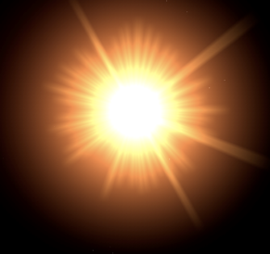
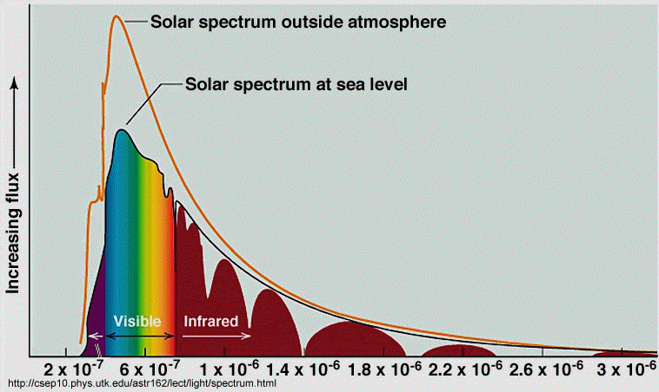
How an Emission Spectrum is Collected
Here is another version with a star as the sample.
Other samples of interest here are colored LEDs (red, green, blue) and some fireworks - such as, green ones made of barium salts, red ones (strontium salts), and blue ones (copper salts).
Sample holder
Yes in this fictitious lab we can have stars in a sample holder.
Students should be able to change out samples from a selection throughout the module.

Slide 5
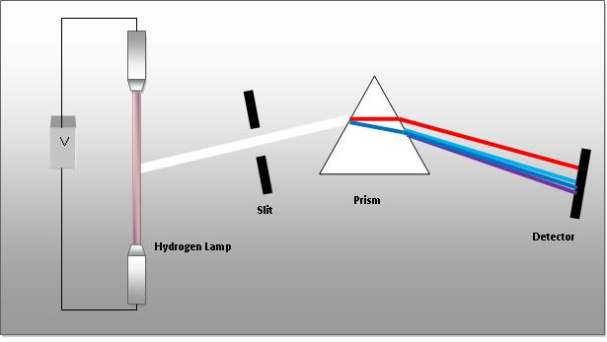
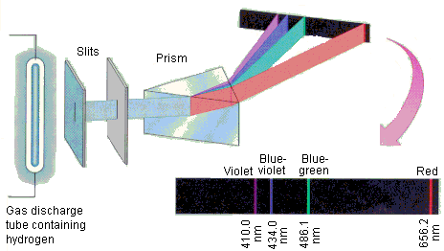
Some ideas for the simulation component layout.
The final product need not be as 2D as the top example.
More importantly, I like how the light coming out of the prism represents the actual components of the input beam.
http://chemwiki.ucdavis.edu/Wikitexts/UCD_Chem_2A/ChemWiki_Module_Topics/Electrons_in_Atoms/Atomic_Spectra
http://chemed.chem.purdue.edu/genchem/topicreview/bp/ch6/bohr.html

Slide 6
Atomic Spectroscopy Simulation
This simulation will be based heavily on the Neon Lights and Other Discharge Lamps Simulation available through the University of Colorado PhET program (see link at bottom of slide).
The simulation should run within the workspace that will be asking them questions as well as requesting that they input some data into their notebook.
The controls for this simulation will be embedded in the interface (see subsequent slides for details).
Students should be able to select a single atom or multiple atoms simulation and observe that for a single atom or a collection of the same atom the same spectrum results.
http://phet.colorado.edu/en/simulation/discharge-lamps

Slide 7
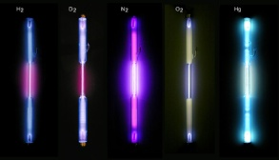
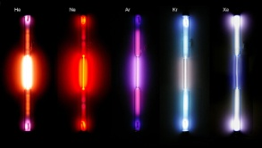
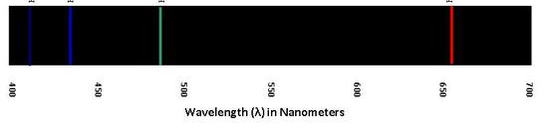
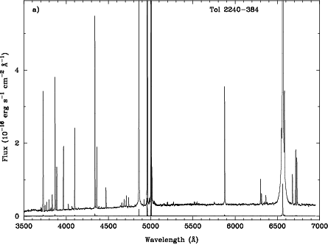

Atomic Emission Spectra: Introduction
Here the students will have a chance to explore the emission spectrum of a variety of discharge tubes.
In order to move on to the next part of the module, students will be prompted to click on the “nanoview” to enter the atomic view of the discharge tube.
Cabinet of discharge tubes.
Students can drag and drop discharge tubes into sample holder.
In this case only the specific emission line colors should be observable. (see slide #5 for some examples from the web.)
It is important that the spectrum displayed is not just the color line spectrum (top display) but also a spectrum of intensity versus wavelength (bottom display).
Nanoview button
Images of discharge tubes from: http://en.wikipedia.org/wiki/Gas-filled_tube

Slide 8
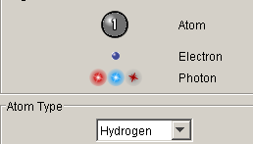
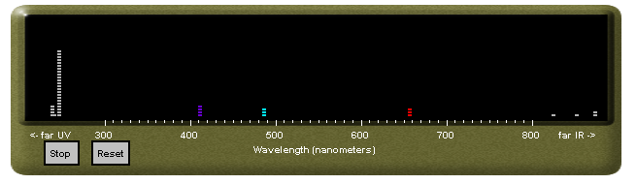
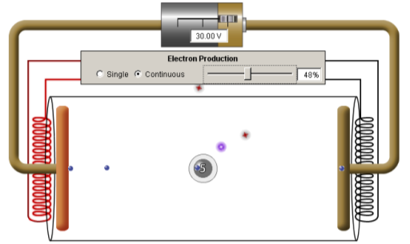
Atomic Emission Spectra (AES): Mode 1 Nanoview
Here is the general layout for the AES Mode 1 Nanoview interface
The discharge tube and spectrum interface are from the PhET simulation discussed in the next slide.
I have discussed the specific changes I want made in the next slide .
This is the legend for this component of the simulation.
Changes are discussed in the next slide.
Students should be able to change the type of atom from a short pull-down list.
Photons emitted in the direction of the spectrometer will be detected and recorded on the spectrum output
Images of discharge tubes from: http://en.wikipedia.org/wiki/Gas-filled_tube

Slide 9
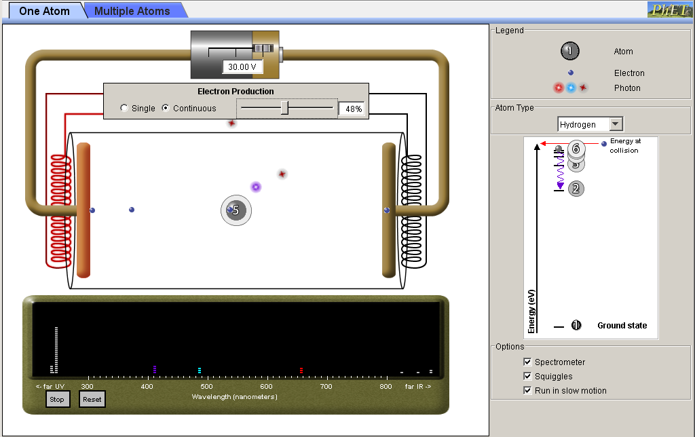
Atomic Emission Simulation Details: Mode 1
The slider should be simplified to “electron energy”
The electron production can be fixed. For now the electron flux can be equivalent to the 50% setting on the PhET simulation
Modifications to legend:
Atom
No need to show the numerical value of the excited electron energy level.
A sphere at this point will suffice.
Electron
Particle representation is fine for this simulation
Photon
I do not like how the PhET simulation represents the photon as a colored glowing particle.
Is it possible to represent it as a travelling squiggle packet of the appropriate color?
At this point the students should not have access to the energy-level representation .
The only option that should be available to them is the “Run in slow motion” and atom-types pull-down option
I like how the spectrum develops in this simulation as each photon is emitted.
IT needs to be clear to the user that the detected photons are the ones emitted in the direction of the detector.

Slide 10
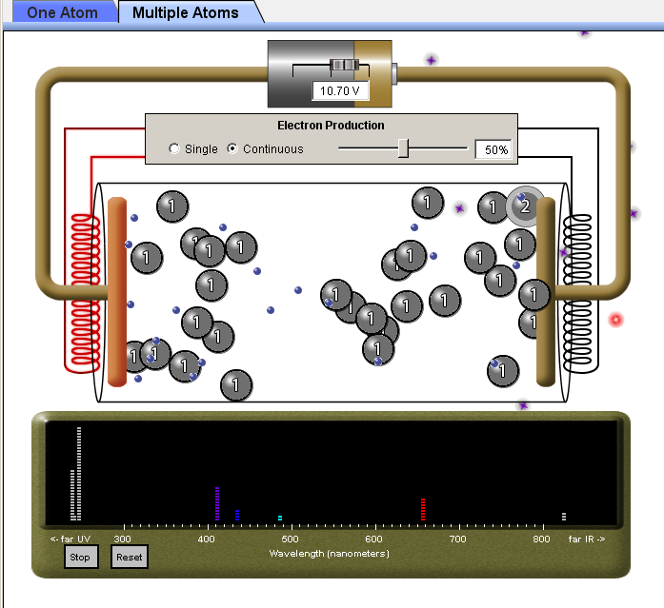
Atomic Emission Simulation Details: Mode 2
Here is what the PhET simulation looks like in Multiple Atoms mode.
All comments and changes discussed in the previous slides apply to this mode as well.
The main take-home message here is that we get the same spectrum out whether we have a single atom or multiple atoms being excited.

Slide 11

Atomic Absorption Spectra: Introduction
Here the students will have a chance to explore the absorption spectra of a variety of gas samples (these ssamples will be the same as those represented by the discharge tubes.
In order to move on to the next part of the module, students will be prompted to click on the “nanoview” to enter the atomic view of the discharge tube.
Cabinet of gas samples.
The tubes should look the same but not be glowing and clearly labeled as to the contents
Students can drag and drop the gas sample into sample holder.
Continuous light source.
Should have an on/off switch so that the students can see that there is no absorption unless the sample is irradiated.
H₂
In this case the absorbed colors will be omitted from the light exiting the prism.
It is important that the spectrum displayed is not just the color line spectrum (top display) but also a spectrum of intensity versus wavelength (bottom display).
NOTE: I could not find an image of an atomic transmission spectrum for hydrogen but, the displayed spectrum should be in transmittance mode NOT absorbance.
Nanoview button
Images of discharge tubes from: http://en.wikipedia.org/wiki/Gas-filled_tube

Slide 12
Simulation Layout
The following slides will present the question flow for this module.
Please refer to the notes below each slide for my ideas on formatting, layout, etc.
Comments in [] are directed at the development team.
Questions are guidelines, if anybody has ideas on how to set them up (i.e. multiple-choice, drag-and-drop, etc.) I welcome them.
Graded question have a (G) after them.
Ungraded free-response question are labeled (U). Ideally these responses will be stored for the report and meta-cognition sections later in the exercise.

Slide 13
Pre-Simulation Questions
This section will contain a series of questions aimed at
Developing mastery in converting between wavelength, frequency, and energy (3 GRADED questions).
These are pretty straightforward conversion questions.
The grading scheme here should be on the Mastery type where a student cannot progress unless they demonstrate the ability to perform each type of conversion.
Qualitative questions interrogating their understanding of the EM spectrum(2 GRADED questions).
These questions can be of the “drag-and-drop” style where they arrange various regions of the EM spectrum by relative energy, wavelength, or frequency.
There should at least be one question that all students must answer regarding the relative energies of photons of different colors in the visible region of the EM spectrum.
Free response question intended to probe student’s preconceptions regarding how matter interacts with light (2 UNGRADED questions but responses should be saved for later review by instructor and student).
Briefly describe in your own words how an energized atom of a particular element emits light.
Some street lamps contain sodium (Na) atoms in the gas phase which is why they produce yellow light while some “neon” lights contain neon (Ne) atoms in the gas phase which is the reason why these lights glow red when those atoms are energized. Why do you think that atoms of different elements emit different colors of light?
Notes:
The Simulated spectrophotometer (SIM-Spec) should not appear yet.

Slide 14

Introduction
This simulation is intended to allow you to explore the phenomena of emission and absorption of light by different objects, materials, and atoms. The simulation is set up so that you will be dealing with data (spectra) that closely resemble the type of information you would obtain if you were to use an actual spectrophotometer.
The two types of spectroscopy you will study are emission and absorption.
Emission spectroscopy is the measurement of light generated by a sample that has been energized through a variety of means (light, heat, or electricity)
Absorption spectroscopy is the measurement of light absorbed by a sample when light is passed through the sample.
Familiarize yourself with the different components of the simulated spectrophotometer by clicking on the information icon ( ) associated with each component.
NOTE: Throughout this module different types of functionality will be added to your SIM-Spec. When a new functionality is added an information icon will appear next to it so that you can familiarize yourself with it.
Spectroscopy Simulation (SIM-Spec):
Intro Mode (c.f. slide #3)
Notes:
At this point there will be an empty sample holder compartment.
The rest of the components should all be visible with the information icon next to them.

Slide 15
Resources for the Simulation Team for Reproducing Spectra
LEDs
LUXEON Rebel Direct Color Portfolio LED.pdf
Excellent resource for max wavelength and full-width at half-maximum information for some LEDs
Can be directly accessed by Google searching ‘Philips “Luxeon Rebel” datasheet’
Atomic Emission Lines
CRC Handbook of Chemistry and Physics: Section 10: Atomic, molecular, and Optical Physics: Line Spectra of the Elements (http://www.hbcpnetbase.com/)
Excellent resource for strongest and typically detectable atomic lines.
For the purposes of this exercise not all lines will be simulated
Only lines between 350 and 900 nm (note that the values in the CRC are in Angstroms)
The relative intensity values given should be used to generate the simulated spectra
The simulated spectra should represent lines as if they were collected on an instrument with 1 nm resolution.
The observed lines should not be actual lines but emission peaks with a 1 nm base centered around the emission maximum.
The samples available to students throughout this entire module are: H₂, Li, Na, Mg, Al, Si, He, Ne, Xe, Ba, Sr, and Hg (some of these are represented in the pictures in slide #10)
Some other useful resources are:
http://astro.u-strasbg.fr/~koppen/discharge/index.html (This website is an excellent resource for how I want the color-line spectra of the elements to look like EXCEPT that instead of a rainbow background have a black one and the linewidth should be 0.5 nm for improved viewing.)
http://jersey.uoregon.edu/vlab/elements/Elements.html (This site contains the emission AND absorption spectra of all the elements.)

Slide 16
Collecting Some Spectra
Pick the incandescent bulb sample and drag it into the sample holder.
Click on the “Collect Spectrum” icon. [For the light bulb, LED, and neon sign portion of this exercise the spectrum scale should only be in the visible.]
Note the general features of the spectrum; shape, intensity values, wavelength region where the light bulb is emitting light (you can scroll over the spectrum and see the values in the lower right-hand corner of the display.
QUESTION A1 (G): At what wavelength does the light bulb emit the most light (maximum intensity)?
QUESTION A2 (G): What is the energy of a photon of this wavelength?
Save the current spectrum
Now increase the brightness of the bulb using the intensity slider on the sample.
Collect a new spectrum.
QUESTION A3 (U): What changed between the two spectra? You can compare the two by clicking on the compare spectra icon.
Spectroscopy Simulation (SIM-Spec):
Intro Mode (c.f. slide #3)
Notes:
A window should appear that contains the following samples:
a light-bulb sample with an intensity slider (add an info icon so the student knows what the slider is for)
three LEDs (see LUXEON Rebel Direct Color Portfolio LED.pdf document Table 2 page 6 and Fig. 4 page 12 for relevant spectroscopic information); RED, GREEN, and BLUE
a neon lamp made of Neon (could be an OPEN sign or an Eat at Joes sign or even a custom WWU or SaplingLearning sign, as long as it is made up of Ne gas)
the sun (as of 8/3/11 I have not found raw spectral data for the solar spectrum, maybe you all have better luck.)
Students should be able to save their spectra so that they can compare them.
(G) = graded question
(U) = ungraded free response quastion

Slide 17
Collecting Some Spectra
Now pick the [random generation of red, green, or blue] LED (light emitting diode) and place it in the sample holder.
Click on the “Collect Spectrum” icon.
Note the general features of the spectrum; shape, intensity values, wavelength region where the LED is emitting light (you can scroll over the spectrum and see the values in the lower right-hand corner of the display.
QUESTION A4 (G): At what wavelength does the LED emit the most light (maximum intensity)?
QUESTION A5 (G): What is the energy of a photon of this wavelength?
QUESTION A6 (G): Does the wavelength region of the emitted light from the LED correspond to its observed color?
QUESTION A7 (U): At what wavelength would you expect the maximum intensity of the [random generation of red, green, or blue but different from above] LED.
Choose that LED, collect a spectrum and confirm your prediction.
Spectroscopy Simulation (SIM-Spec):
Intro Mode (c.f. slide #3)

Slide 18
Collecting Some Spectra
Now select the neon sign and place it in the sample holder. This particular neon sign actually contains Ne atoms in the gas phase that are energized when electrical current passes through the lamp.
Click on the “Collect Spectrum” icon.
Note the general features of the spectrum; shape, intensity values, wavelength region where the neon sign is emitting light (you can scroll over the spectrum and see the values in the lower right-hand corner of the display.
Save the spectrum. Collect and save a spectrum of the red LED and compare it to that of the neon sign.
QUESTION A8 (G): The neon sign also appears red, does its spectrum match that of the red LED?
QUESTION A9 (U): What features of the neon spectrum contribute to its observed color?
The peaks in the spectrum of the neon sign are called spectral lines as opposed to the broad features observed for the light-bulb and the LEDs
QUESTION A10 (G): In what region(s) of the visible EM spectrum do the majority of the lines in the neon sign spectrum appear? [multiple choice with multiple selections; I am looking for Red-Orang-Yellow]
Spectroscopy Simulation (SIM-Spec):
Intro Mode (c.f. slide #3)

Slide 19
Collecting Some Spectra
Now select the sun and place it in the sample holder.
Click on the “Collect Spectrum” icon.
Note the general features of the spectrum; shape, intensity values, wavelength region where the sun is emitting light (you can scroll over the spectrum and see the values in the lower right-hand corner of the display.
Save the spectrum.
QUESTION A11 (G): Which type of spectrum does the solar spectrum resemble the most? [M.C. light-bulb, LED, neon sign]
QUESTION A12 (G): In what region of the visible EM spectrum is the sun’s emission spectrum most intense? [M.C.]
QUESTION A13 (U): Does the sun appear to be this color to us? Explain.
Spectroscopy Simulation (SIM-Spec):
Intro Mode (c.f. slide #3)

Slide 20
Types of Spectra
For the purposes of the exercise we will describe spectra using three characteristics:
Whether the collected spectrum is a continuous spectrum –the sample emits all the wavelengths over a relatively broad region of the EM spectrum - or a line (discreet) spectrum – the sample emits light in narrow regions of the EM spectrum separated by areas where no light (zero intensity) in emitted.
Wavelength(s) of maximum intensity, λ_{max}.
The width in nm of the spectral features. Typically this is reported as the width of the feature at half its maximum intensity (FWHM). [A figure illustrating how to measure FWHM of a spectral band would be very helpful to the student here.]
EXERCISE A14 (G): Organize your saved spectra as either continuous or discreet. [This is a labeling exercise where the students can drag-and-drop the discreet or continuous labels into a box below their spectra.
EXERCISE A15 (G): Report the λ_{max} of the spectral features in all your saved spectra.
EXERCISE A16 (G): Determine the FWHM of the solar, LED as well as the [random generated value from the list of Ne lines] spectral features.
EXERCISE A17 (U): How do these factors influence the overall color we observe from the light source?
Window with student saved spectra.
Notes:
The students should now be able to recall their saved spectra and compare/contrast them.
One way these questions could be set-up is to have a series of spectral qualities that the students drag and drop into boxes below their saved spectra
the objective here is to distinguish the spectra as continuous or discreet and be able to determine the broadness and lambda max of their spectra.

Slide 21
Types of Spectra
Typical spectrophotometers will represent emission data in the form of a spectrum which is a plot of intensity (number of photons striking the detector over a period of time) of light emitted on they-axis and wavelength on the x-axis. Your text and numerous other resources use an alternative format for depicting the emission spectrum of atoms which we will call the color-line spectrum. In this type of representation the emission information is depicted as a series of colored lines on a black background. This representations depicts regions of zero intensity as black and the wavelength of the emission line within the visible region of the EM spectrum is represented by its color.
Let’s revisit the visible emission spectrum of neon. Notice that the SIM-Spec depicts the emission spectrum in both formats.
QUESTION A18 (G): How is the intensity of an emission line represented in the color-line spectrum format? [M.C. the color, the thickness of the line, the intensity of the color]
QUESTION A19 (G): How is the broadness (FWHM) of an emission feature represented in the color-line format? [M.C. with same choices]
Spectroscopy Simulation (SIM-Spec):
Intro Mode (c.f. slide #3)
Notes:
In this section the samples are now only discharge tubes containing the following elements: H₂, Ne, Na, Ba, Sr, and Xe.
Students should be able to access their answer to QB1 and modify it. The report output should have both answers (before and after).

Slide 22
Let’s Think About It.
This section will contain a series of questions aimed at getting students to understand that light is a form of energy and the emission of light is a manner in which excited-state matter can lose energy.
Questions 1 and 2 are graded with feedback.
Question 3 is a free response ungraded question for the report or some sort of drag-and-drop exercise.
When a sample emits photons of light is it gaining or losing energy?
Multiple-choice with feedback
The amount of energy lost by a sample is related to..(select all that apply)
Options to select from include: wavelength of the photon, frequency of photon, speed of the photon, mass of the photon (any other good distractors are welcome).
Where does the energy that the sample (light-bulb, LED, neon lamp) is losing come from?
In this case they will have an input box for each type of sample looked at so far.
Notes:
The Simulated spectrophotometer (SIM-Spec) should not appear yet.

Slide 23
Let’s Think About It.
When energy is added to a sample, the atoms within that sample become energetically excited. These energized atoms are said to be in an excited-state rather than the state they are in under “normal” conditions (low temperatures like room temperature and atmospheric pressure) – termed the ground-state.
A convenient way of depicting these higher energy states in a graphical model is to draw a simple energy diagram [a visual example like the one below is needed].
These types of diagrams contain the following features:
Energy is represented on the vertical axis relative to the lowest energy state (ground-state)
Lines represent different energetically excited states
Arrows represent transitions between these states.
Excited-state
Increasing Energy
Transition between the excited-state and ground-state
Ground-state

Slide 24
Let’s Think About It.
The energy diagrams are useful in understanding the energetic changes a particular atom or material undergoes.
Below are two energy diagrams representing loss of energy from two different excited-states. The ΔE value is the difference in energy in J between the two states. Answer the following questions regarding these two diagrams.
Excited-state
Increasing Energy
ΔE = 4.81×10⁻¹⁹ J
Increasing Energy
Excited-state
ΔE = 3.27×10⁻¹⁹ J
Ground-state
Ground-state
1a. Which diagram represents a transition where the greater amount of energy is lost?
1b. If the energy in each diagram is lost in the form of a photon of visible light calculate the wavelength of the photon lost in each example.
1c. Assign each photon to the appropriate region of the EM spectrum. If it is part of the visible region then assign the correct color. [This could be a drag-and-drop type question where the student could drag the value or an icon such as photonA and photonB onto a scale representing the EM spectrum.]

Slide 25
Let’s Think About It.
TASK: Draw a representative energy level diagram for the light-bulb, the [randomly chosen color] LED, and the selected region of the neon lamp spectrum [show a spectrum from 650-670 nm]. Be sure to consider how you could build an energy diagram that represents the different types of spectra (i.e. broad and continuous versus narrow and discreet. You can check the relevance of your model by clicking the “check model” button which will generate a spectrum based on your model for comparison to your saved spectra.
[Note to designers]:
I envision this task being of a Guided Inquiry nature. Questions are under construction.
In this TASK a tool should be available where students can drag a series of components onto a blank energy diagram that contains the y-axis and the ground-state. Here is some functionality I am thinking of:
They can select from a single excited state or have the option to build a “thicker” cluster of excited states where the thickness can be related to the FWHM in terms of energy.
They can then drag this onto their energy diagram and add an transition arrow. The relative position of the excited-state manifold can then be set by inputting a transition energy based on the λ_{max} value from the spectra.
Energy Diagram Builder Tool
Excited-state
Increasing Energy
Transition between the excited-state and ground-state
Ground-state

Slide 26
Atomic Emission Spectra [visible region only]
In this section we will explore the emission of a series of gas-filled discharge tubes. Much like the neon sign, these glass tubes contain a low-pressure gaseous sample of a particular element. When a voltage is applied across the tube through electrodes at either end; the discharge tube will emit light. “Neon” signs are one of the most common applications of gas-filled discharge tubes but by no means the only one. The general phenomenon of atomic emission has various applications ranging from entertainment (fireworks), environmental analysis (the quantitation of elements in samples), and astronomy (the characterization of the composition of stars).
QUESTION B1 (U): Do you think that discharge tubes filled with different elements will produce similar or different spectra? Briefly explain your reasoning.
You already analyzed the spectrum of neon. Now let’s explore the spectra of other elements.
Select the H discharge tube, collect a spectrum, and save it.
Select the Ne discharge tube, collect a spectrum, and save it.
QUESTION B2 (G): Which features of this spectrum are similar to that of neon and which are different? [This could be a drag-and-drop type exercise where they have the choice of discreet spectrum, continuous spctrum, λ_{max}, and FWHM]
QUESTION B1’ (U): Revisit and modify, if necessary, your answer to question B1 based on your observations.
Spectroscopy Simulation (SIM-Spec):
Atomic Emission Macro: Mode 1 (c.f. slide #7)
Notes:
In this section the samples are now only discharge tubes containing the following elements: H₂, Li, Na, Mg, Al, Si, He, Ne, Ba, Sr, and Hg .
At this point a window where they can pull up saved spectra and directly compare them should be accessible. They should have an input field for the wavelength region they want to look at for both spectra.
Students should be able to access their answer to QB1 and modify it in QB1’. The report output should have both answers (before and after).

Slide 27
Atomic Emission Spectra [Periodic Trends]
Let us continue to think about the spectra of H and Ne.
Zoom-in on the visible region of both spectra by inputting 400 nm and 700 nm in the x-axis zoom in fields.
QUESTION B3 (G): Which element, H or Ne, has more valence electrons?
QUESTION B4 (G): Which element, H or Ne, appears to have more excited states emitting light in the visible region of the EM spectrum?
Now take a look at the visible spectra of all the discharge tubes available. As you analyze these spectra think about the differences between the spectra as you compare elements in the same period and elements in the same group
QUESTION B5 (U): Are there any periodic trends within a period that you can devise from the available spectra?
QUESTION B6 (U): Are there any periodic trends within a group that you can devise from the available spectra?
QUESTION B7 (U): Can you think of other properties of these elements that correlate to your trends?
Spectroscopy Simulation (SIM-Spec):
Atomic Emission Macro: Mode 1 (c.f. slide #7)

Slide 28
Atomic Emission Spectra [Atomic Scale]
We are now going to consider what is happening in the discharge tubes on the atomic or nano scale.
QUESTION B8 (U): Do you think that each excited atom in the discharge tube emits all the wavelengths of light observable in the spectrum at once? Explain.
Click on the nano-view icon to observe what is occurring in the discharge tube when only one atom is present.
You spectrometer is now counting every single photon that is emitted towards the detector. Each block in the bar-graph read-out represents one photon of a particular wavelength detected.
The energy added to the atom comes from the electric discharge passing through the tube.
Let the experiment run for a couple of minutes.
QUESTION B8’ (U): Revisit your answer to B8 based on your observations.
QUESTION B9 (G): Does the spectrum collected after a few minutes resemble the emission spectrum collected earlier?
QUESTION B10 (U): What factors would have to change in order for the entire emission spectrum to be collected instantaneously? [M.C.: energy, number of atoms, size of discharge tube…other distractors?]
Spectroscopy Simulation (SIM-Spec):
Atomic Emission Nano: Mode 2 (c.f. slide #8)
Notes:
At this point the subset of discharge tubes narrows down to the same set available in the PhET simulation.
The specific tube a student is studying can be randomly selected

Slide 29
Atomic Emission Spectra [Atomic Scale]
Let’s see what happens when we have multiple atoms in the discharge tube.
Click on the multiple atoms button and run the experiment.
QUESTION B11 (G): Was the overall emission spectrum observed sooner with more atoms?
QUESTION B12 (G): Focus your attention to one atom in your sample. Is that atom in your sample always only emitting a photon of a particular wavelength or does it emit photons of different wavelengths each time it is energized?
QUESTION B13 (G): Using the energy diagram tool draw an energy diagram representing an atom in your discharge tube producing a photon of one of the observed emission lines.
QUESTION B14 (G): Using the energy diagram tool draw an energy diagram representing two atoms in your discharge tube producing photons of two different observed emission lines.
QUESTION B15 (G): Using the energy diagram tool draw an energy diagram representing one atom in your discharge tube capable of producing photons of two different observed emission lines.
Spectroscopy Simulation (SIM-Spec):
Atomic Emission Nano: Mode 2 (c.f. slide #8)
Notes:
At this point the subset of discharge tubes narrows down to the same set available in the PhET simulation.
The specific tube a student is studying can be randomly selected

Slide 30
Atomic Absorption Spectra [visible region only]
In this section we will explore a complementary phenomenon to emission, atomic absorption. You will notice that spectrophotometer components have not changed with the exception that a light source is added in order to pass light through your sample. In this experiment we are observing the amount of light absorbed by the sample at particular wavelengths rather than the amount of light generated by an energized sample. The SIM-Spec records how much light is transmitted through the sample at each wavelength compared to the amount of light transmitted without any sample present. This value is plotted as % transmittance (%T). If the %T is less than 100% then that indicates that our sample absorbed photons of light at that particular wavelength.
Take a moment to explore the apparatus using the information icons.
QUESTION C1 (U): Do you think there will be any relationship between the emission spectrum of an element and its absorption spectrum? Explain.
Measure the absorption spectra of H and Ne.
Select the H sample tube, collect a spectrum, and save it.
Select the Ne discharge tube, collect a spectrum, and save it.
Access the Compare Spectra interface and compare the H emission spectrum to the H absorption spectrum. Do the same for Ne.
QUESTION C1’ (U): What relationship did you observe between the emission and absorption spectra of a particular element.
Spectroscopy Simulation (SIM-Spec):
Atomic Absorption Macro: Mode 3 (c.f. slide #11)
Notes:
In this section the samples are now gas tubes containing the following elements: H₂, Li, Na, Mg, Al, Si, He, Ne, Ba, Sr, and Hg. These are NOT discharge tubes but simple containers full of gaseous samples of these elements.
New information icons should appear for the light source, sample type, and the different y-axis in the spectrum. For simplicities sake we will be plotting % transmittance in order to avoid a lengthy discussion of the logarithmic nature of the Absorbance scale. There is no need to talk about the Beer-Lambert relation as we are not doing quantitative work.
Students will need to access their emission spectra for comparison to the absorption spectra.

Slide 31
Atomic Absorption Spectra [analysis]
QUESTION C2 (U): What happens to the sample as it absorbs photons of light? Remember that in this experiment the atoms of your sample are initially in their ground state.
QUESTION C3 (U): Can an atom absorb photons of any wavelength? Support your answer with spectral data.
TASK: Build energy diagrams for the absorption of light by H and Ne atoms and compare them to the ones developed for the emission spectra.
Access the energy diagram builder tool and call up your emission and absorption spectra for hydrogen.
Draw an energy diagram representing the H emission line at [randomly generated visible line].
Draw an energy diagram representing the H absorption line corresponding to that emission line.
Repeat the process for the [randomly generated Ne visible line] Ne emission and absorption lines.
QUESTION C3’ (U): Use the energy level diagrams you generated in the TASK to further support your answer to QC3.
QUESTION C4 (U): If a sample of Na atoms is subjected to light of x nm (a wavelength not absorbed), do you think that the atom will absorb photons of light and become excited? Explain.
Energy Diagram Builder Tool
Excited-state
Excited-state
Increasing Energy
Transition between the excited-state and ground-state
Increasing Energy
Ground-state
Ground-state

Slide 32
Let’s Think About It.
Let us try and add a further level of detail to our understanding of the process by which an atom absorbs or emits light. We will consider the He atom for the purposes of this discussion.
QUESTION C5 (G): Below are two models of the He atom. [Picture of the “plum-pudding” model of an He atom and a Rutherford nuclear model – NOT the Bohr model! The electrons in the Rutherford model should occupy a diffuse cloud around the nucleus without any fine structure.] Which picture best represents relative position of the subatomic particles (protons, neutrons, and electrons)?
QUESTION C6 (U): What force holds the electrons to the atom? [M.C.]
The negatively charged electrons and the positively charged protons in the He atom experience an attractive Coulombic (electrostatic) force. This attractive force must be overcome in order to remove an electron from the neutral He atom to form the cation (He⁺). The energy needed to remove the first electron is the first ionization energy of He (2372.3 kJ/mol). On the other hand, neutrons and protons in the nucleus are held together through the strong nuclear force which is different for each isotope of each element. For the He-4 iostope the value of the strong nuclear force is 2.7303×10⁹ kJ/mol.
QUESTION C7 (G): Calculate the wavelength of a photon of light with energy corresponding to the strong nuclear force in He. Hint: you must calculate the value of the force per nucleon first.
QUESTION C8 (G): What region of the EM spectrum corresponds to photons with this energy?
QUESTION C9 (G): Calculate the wavelength of a photon that has enough energy to ionize He. Hint: you must calculate the ionization energy per atom first.
QUESTION C10 (G): What region of the EM spectrum corresponds to photons with this energy?

Slide 33
Let’s Think About It.
The highest energy observable emission/absorption line for neutral atoms of your available samples are listed in the table below.
Element | Emission Line (nm) | Element | Emission Line (nm)
H | 97.2537 | He | 58.4334
Li | 610.354 | Ne | 73.5896
Na | 285.281 | Mg | 285.213
Al | 237.312 | Si | 162.943
Sr | 403.038 | Xe | 129.559
Ba | 350.111 | Hg | 126.882
QUESTION C11 (G): Are the typical energies observed for atomic emission and absorption spectra on the order of the strong nuclear force or ionization energies? [This question will require some key feedback to help the students connect the dots.]
QUESTION C12 (U): In the atomic emission and absorption experiments we have investigated throughout this module atoms absorb a photons of light or excited atoms emit a photons of light. At this point you have developed an energetic model for this phenomenon (energy level diagrams) and looked at the typical energies of photons involved in these processes. Discuss in your own words what specific component of the atom (nucleus, protons, neutrons, or electrons) is/are involved in the processes of atomic emission and absorption. Use any spectra and energy-level diagrams you have collected and built throughout this module to support your conclusions.
Notes:
Question C12 is a rewording of the two free-response questions posed at the beginning of the module.

Slide 34
Developing the Bohr Model
My brain hurts….any advice regarding how to finish this off and lead the students to the Bohr model is GREATLY appreciated.

Slide 35
Some Additional Questions/Discussion
Compare the discharge tube phenomenon with flame tests and fireworks.
Have students choose the best element for a specific color firework based on atomic emission data
Identify elements in a star based on the atomic absorption lines.
Final wrap-up questions: revisit first two free-response questions.
Briefly describe in your own words how an energized atom of a particular element emits light.
Some street lamps contain sodium (Na) atoms in the gas phase which is why they produce yellow light while some “neon” lights contain neon (Ne) atoms in the gas phase which is the reason why these lights glow red when those atoms are energized. Why do you think that atoms of different elements emit different colors of light?

Slide 36
Models of the Atom
Three available models:
The plum pudding model where electrons and protons occupy the entire volume of the atom and are held together by electrostatic attractions.
The Rutherford model where the protons are in a small, dense nucleus and the electrons are in a “cloud” around the nucleus.
The Bohr model where the electrons occupy discreet orbits around the nucleus.

Slide 37
Appendix
Blackbody Material
(May be eliminated from Module)

Slide 38
Blackbody Emission Spectrum Simulation
This simulation will be based heavily on the Blackbody Spectrum Simulation available through the University of Colorado PhET program (see link at bottom of slide).
The simulation components within a workspace that will be asking them questions as well as requesting that they input some data into their “notebook”.
The controls for this simulation should be embedded in the opening interface (see following slides).
Most importantly it must be evident to the student that they are studying condensed matter and not a single atom.
http://phet.colorado.edu/en/simulation/blackbody-spectrum

Slide 39

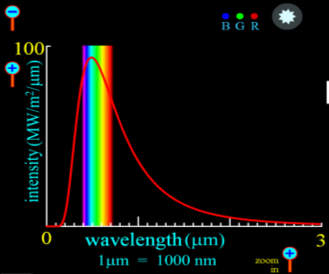
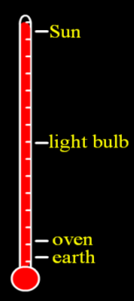
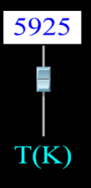
Blackbody Emission Simulation Details: Mode 1
Students should be able to swap out samples and vary the temperature of each.
As the temperature is changed the sample should also change color and brightness.
I am not sure what the best way to demonstrate brightness will be. Maybe the Sapling artists have some suggestions.
If the temperature gets too hot for the oven coil or light bulb samples then the sample should self-destruct – melt or explode.
Students use slider or text input box to change T.
Thermometer changes accordingly.
The x and y-axis zoom icons should stay associated with the spectrum either where they are in the PhET sim or on the console but obviously near the associated axis.

Slide 40
Blackbody Emission Simulation Details: Mode 2
In this mode the students will be presented with an actual stellar spectrum.
The stellar spectrum will be presented to them.
The rainbow graphic overlaying the wavelengths of the visible region should be present in this spectrum.
Students should be able to zoom in/out on both axes.
The predicted spectrum will appear as a smooth line of a different color on the same plot so that they can compare the two.
The color and brightness of their theoretical star will change as they change T.
Students use slider or text input box to change T.
The spectrum readout changes accordingly.
COMPARE SPECTRUM
Students will be able to click on this button to overlay their theoretical spectrum with the given stellar spectrum above.

Slide 41
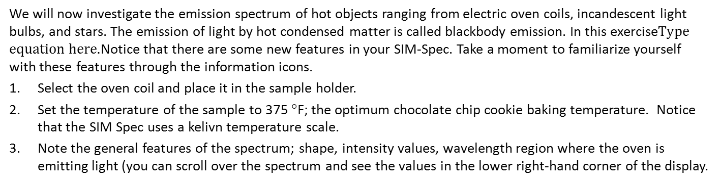
Spectra of Hot Objects
Spectroscopy Simulation (SIM-Spec):
Blackbody (c.f. slides #6-8)
Notes:
A window should appear that contains the following samples:
an oven coil
a light-bulb sample without the intensity slider
a star
Information icons for the temperature slider, thermometer readout, and spectrum axis zoom buttons should appear.
The “collect spectrum” icon is removed as the simulation will constantly produce a spectrum as they move the temperature slider
The spectral output is now over a much broader wavelength range and reported in micrometers rather than nanometers.

Slide 42
Spectra of Hot Objects
Select the oven coil and place it in the sample holder.
Set the temperature of the sample to 375 °F; the optimum chocolate chip cookie baking temperature. Notice that the SIM Spec uses a kelivn temperature scale.
Note the general features of the spectrum; shape, intensity values, wavelength region where the oven is emitting light (you can scroll over the spectrum and see the values in the lower right-hand corner of the display.
QUESTION (G): At what wavelength (in nm) does the oven emit the most photons (maximum intensity)?
QUESTION (G): In what region of the EM spectrum are the majority of the photons emitted by the hot oven? [M.C.]
Spectroscopy Simulation (SIM-Spec):
Blackbody (c.f. slides #6-8)
Notes:
A window should appear that contains the following samples:
an oven coil
a light-bulb sample without the intensity slider
a star
Information icons for the temperature slider, thermometer readout, and spectrum axis zoom buttons should appear.
The “collect spectrum” icon is removed as the simulation will constantly produce a spectrum as they move the temperature slider
The spectral output is now over a much broader wavelength range and reported in micrometers rather than nanometers.

