Slide 1
Osmosis Slider
HTML 5 Interactive

Slide 2
Basic Idea
slider allowing students to drag concentration from isotonic to hypotonic or hypertonic. As they drag, they are really just dragging two movies
bio14_3-3-13_hypotonicenv.mp4 and
bio14_3-3-14_hypertonicenv.mp4
This should be very simple and fast (hopefully) to do

Slide 3
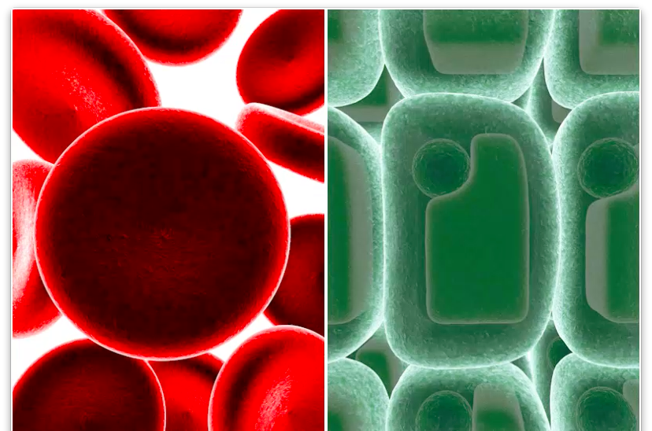
Cells:
Hypotonic
Isotonic
Hypertonic
Solutions:
Hypertonic
Isotonic
Hypotonic
Notes:
The center is just a still (the first frame of each movie)

Slide 4
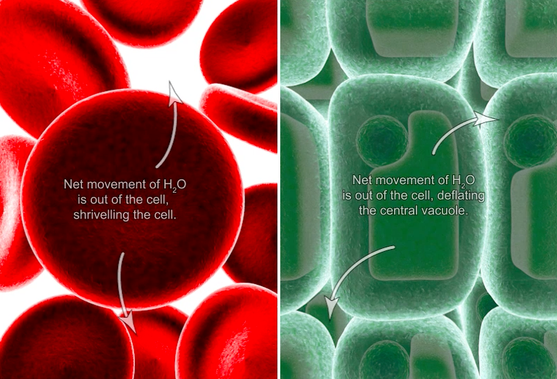
Cells:
Hypotonic
Isotonic
Hypertonic
Solutions:
Hypertonic
Isotonic
Hypotonic
Notes:
The side controls bio14_3-3-14_hypertonicenv.mp4

Slide 5
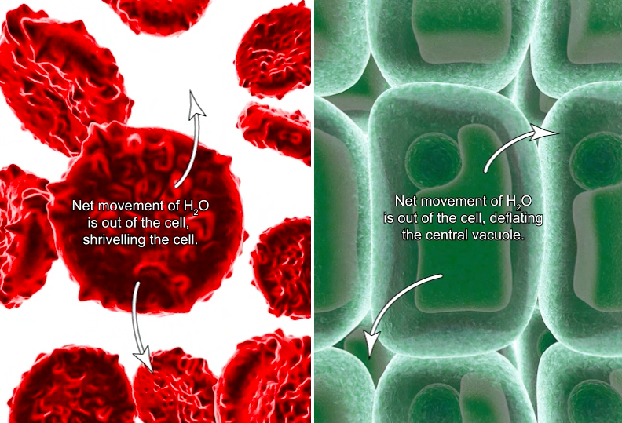
Cells:
Hypotonic
Isotonic
Hypertonic
Solutions:
Hypertonic
Isotonic
Hypotonic
Notes:
The side controls bio14_3-3-14_hypertonicenv.mp4

Slide 6
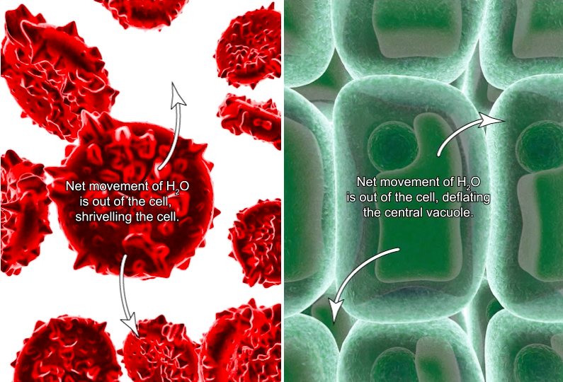
Cells:
Hypotonic
Isotonic
Hypertonic
Solutions:
Hypertonic
Isotonic
Hypotonic
Notes:
The side controls bio14_3-3-14_hypertonicenv.mp4

Slide 7
Cells:
Hypotonic
Isotonic
Hypertonic
Solutions:
Hypertonic
Isotonic
Hypotonic
Notes:
The center is just a still (the first frame of each movie)

Slide 8
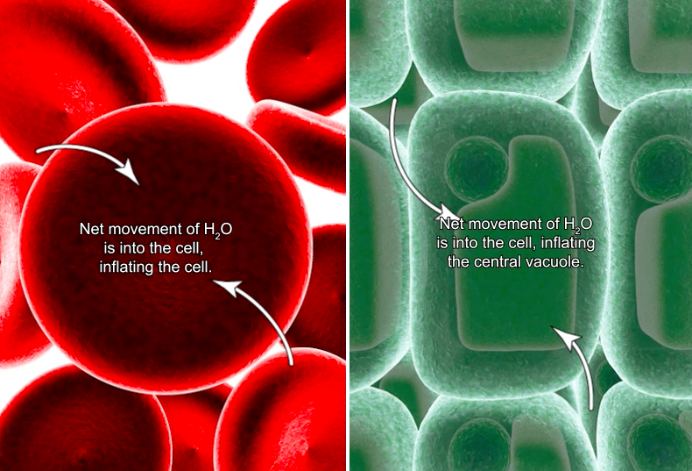
Cells:
Hypotonic
Isotonic
Hypertonic
Solutions:
Hypertonic
Isotonic
Hypotonic
Notes:
The side controls bio14_3-3-13_hypotonicenv.mp4

Slide 9
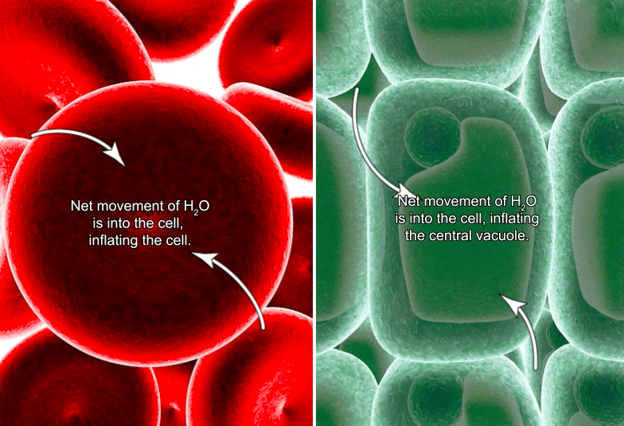
Cells:
Hypotonic
Isotonic
Hypertonic
Solutions:
Hypertonic
Isotonic
Hypotonic
Notes:
The side controls bio14_3-3-13_hypotonicenv.mp4

